Slide 1
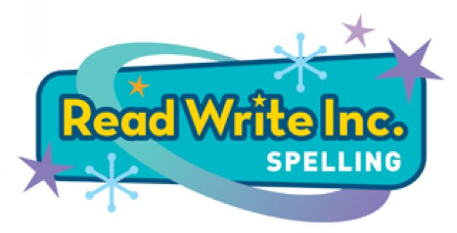
Lawley Village Academy
Parent Workshop
20th March 2019

Slide 2
Aims of the workshop
Explain how the RWI spelling programme works
Show a range of activities used within the programme
Answer any questions about the RWI spelling programme

Slide 3
Why is spelling so important?
A child wanted to write: an enraged Rottweiler was a fearsome beast!
The child wrote: The cross dog barked.
We are all guilty of choosing an easier word if we don’t know how to spell the word we want. We want to remove this barrier to spelling to unlock every child’s potential in writing!
However spelling in English is hard!
The language has 26 letters
When we speak we use 44 speech sounds:
24 consonant speech sounds
20 vowel speech sounds
This forms about half a million words in current use!

Slide 4
What is RWI spelling?
RWI Spelling embeds impressive skills quickly and effectively filling the gaps in children’s knowledge. To keep children engaged they complete quick-fire activities in their spelling practice books. Progress is accurately recorded using practice tests and ongoing assessment.
The programme develops children’s knowledge of word families, how suffixes impact upon root words, and provides mnemonics to remember the trickiest spellings.

Slide 5
Why RWI spelling?
Uses partner work to help children learn effectively and recall what they have learnt
Moved away from the “memorise a list” spelling structure
Children were not applying spelling knowledge in their writing
Carries on from the successful RWI phonics programme in school
Covers all the spelling requirements of the National Curriculum
Engaging!

Slide 6
RWI spelling at Lawley
Starts in year 2 when children complete the RWI phonics programme
4 times a week
15 minute sessions
Children work in banded groups suited to their spelling ability

Slide 7
The programme structure
15 minutes per session
Programme made up of units, each unit is new a spelling rule
Every unit includes 11 engaging activities
Each unit follows the same pattern of activities
Half termly assessments as well as mini spelling checks throughout each unit

Slide 8
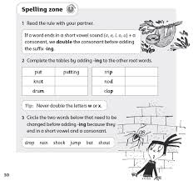
The spelling zone!
Each new spelling concept is introduced by aliens on an exciting online spelling planet
The spelling zone is visited at the start of each unit
3 alien characters to engage the children

Slide 9
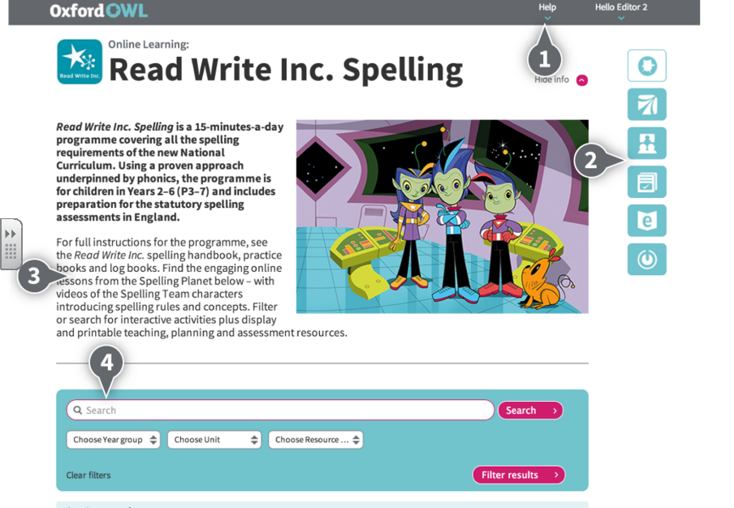
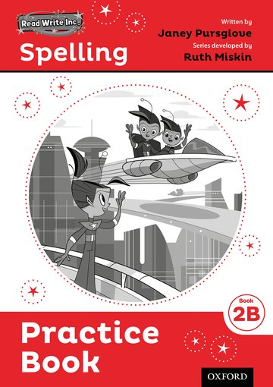
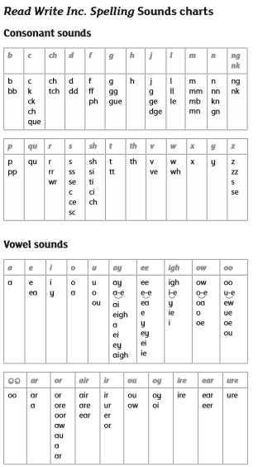
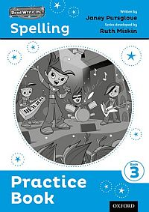
The resources

Slide 10
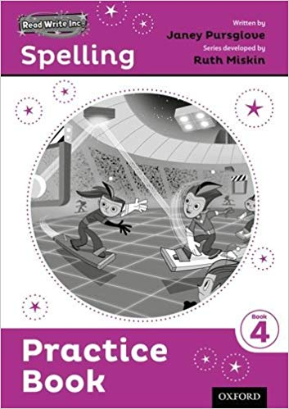
The activities
Speed spell
Spelling Zone
Dots and Dashes
Rapid Recall
Word Changers
Words to log and learn
Dictation
Four-in-a-row
Choose the right word
Team teach
Jumping red/orange words

Slide 11
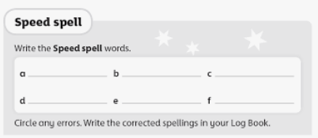
Speed spell
Speed spell revisits words from the previous unit to assess secure understanding of the spelling rule

Slide 12
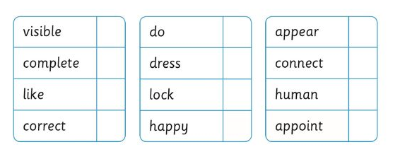
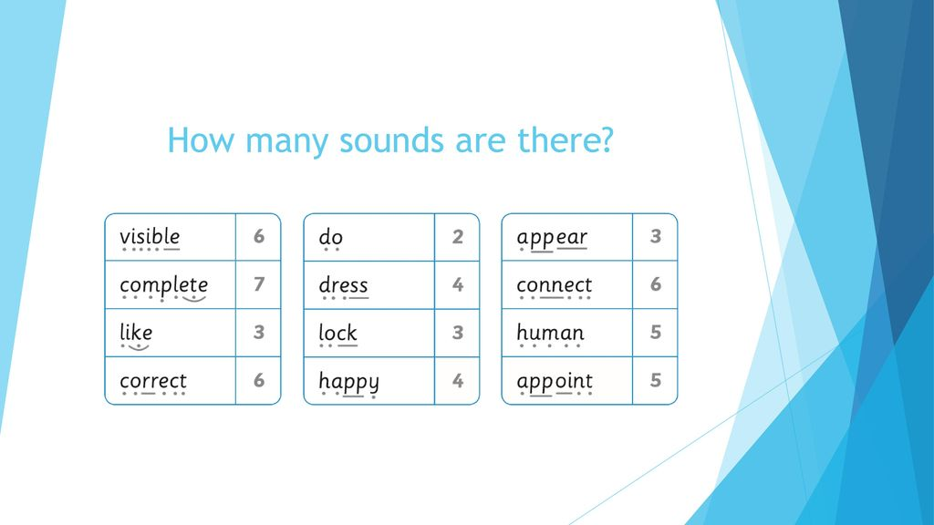
Dots and Dashes
A speedy activity to regularly reinforce the ‘pure sounds’ within words, including the spelling rule taught in the unit.

Slide 13
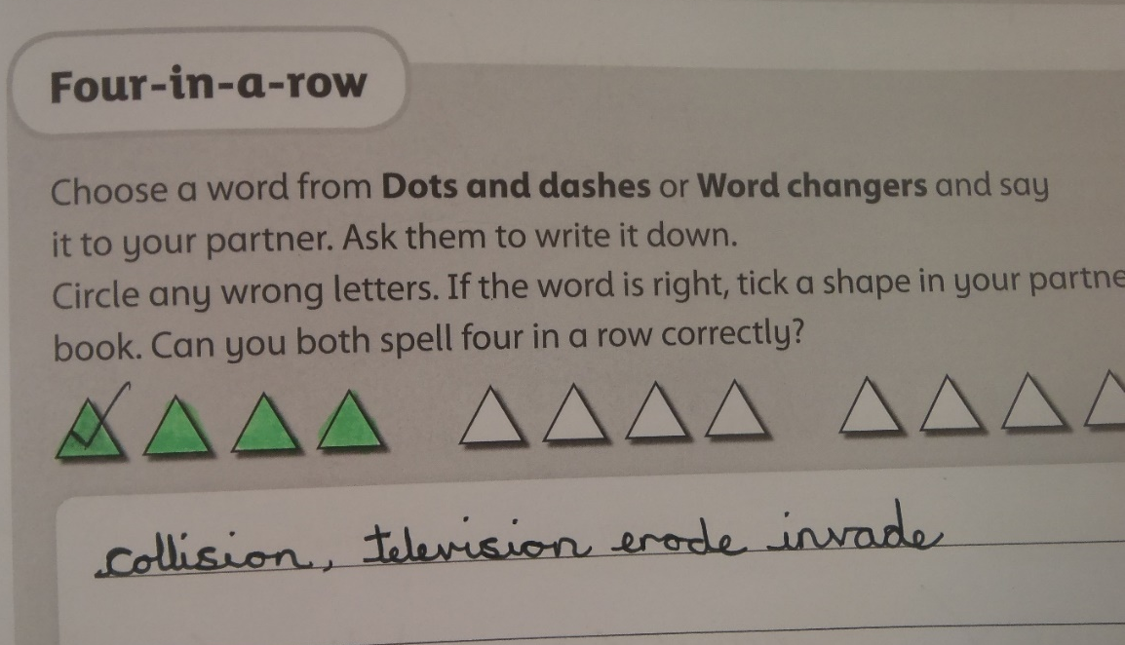
Four-in-a-row
A fun, partner game requiring the children to test one another on words from the current unit.
The first to get 4 in a row… wins!

Slide 14
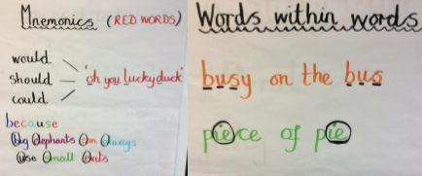
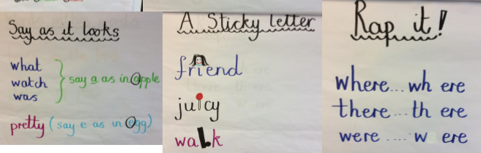
Jumping red/orange words
These are words that the National Curriculum requires children to spell by the end of each year
At the end of each unit these are tested
Once the group is secure on a word it is “removed” from the learning box!

Slide 15
How you can support your child at home
Practice words children note down in their log books
Revisiting words from previous units found in the log book
Encourage children to use their phonic sounds when writing/spelling
Fun activities such as creating word searches or crosswords

Slide 16
More information
Visit the parent pages on the Ruth Miskin Training website.
Sign up to the Ruth Miskin Training newsletter.
Access free e-books for home reading at the Oxford Owl Website.
Visit the Read Write Inc. website.

